Slide 1

Negociaciones agrícolas en la OMC: ¿qué está en juego en la Conferencia Ministerial de Buenos Aires?

Slide 2


MC11: A new opportunity to reduce distortions in the agricultural global trade system
David Laborde, Valeria Piñeiro, Joe Glauber

Slide 3

Overview
What should be done to reduce distortions in agricultural world markets?
What can be done to reduce distortions in agricultural world markets?
Quantifying options
Notes:
Inherited from the UR
Imbalances

Slide 4

Existing WTO framework
Anexo 2 del Acuerdo sobre la Agricultura
  Anexo 2- Compartimento verde
Artículo 6 del Acuerdo sobre la Agricultura
  Párrafo 2- Programas de desarrollo
  Párrafo 5- Programas que limitan la producción (compartimiento azul)
  Párrafo 4- De minimis
  Párrafo 3- MGA total corriente
Playing with Boxes: Green, Blue and Amber
Notes:
Inherited from the UR
Imbalances

Slide 5
Changing Markets
Fuente: Laborde 2014

Slide 6
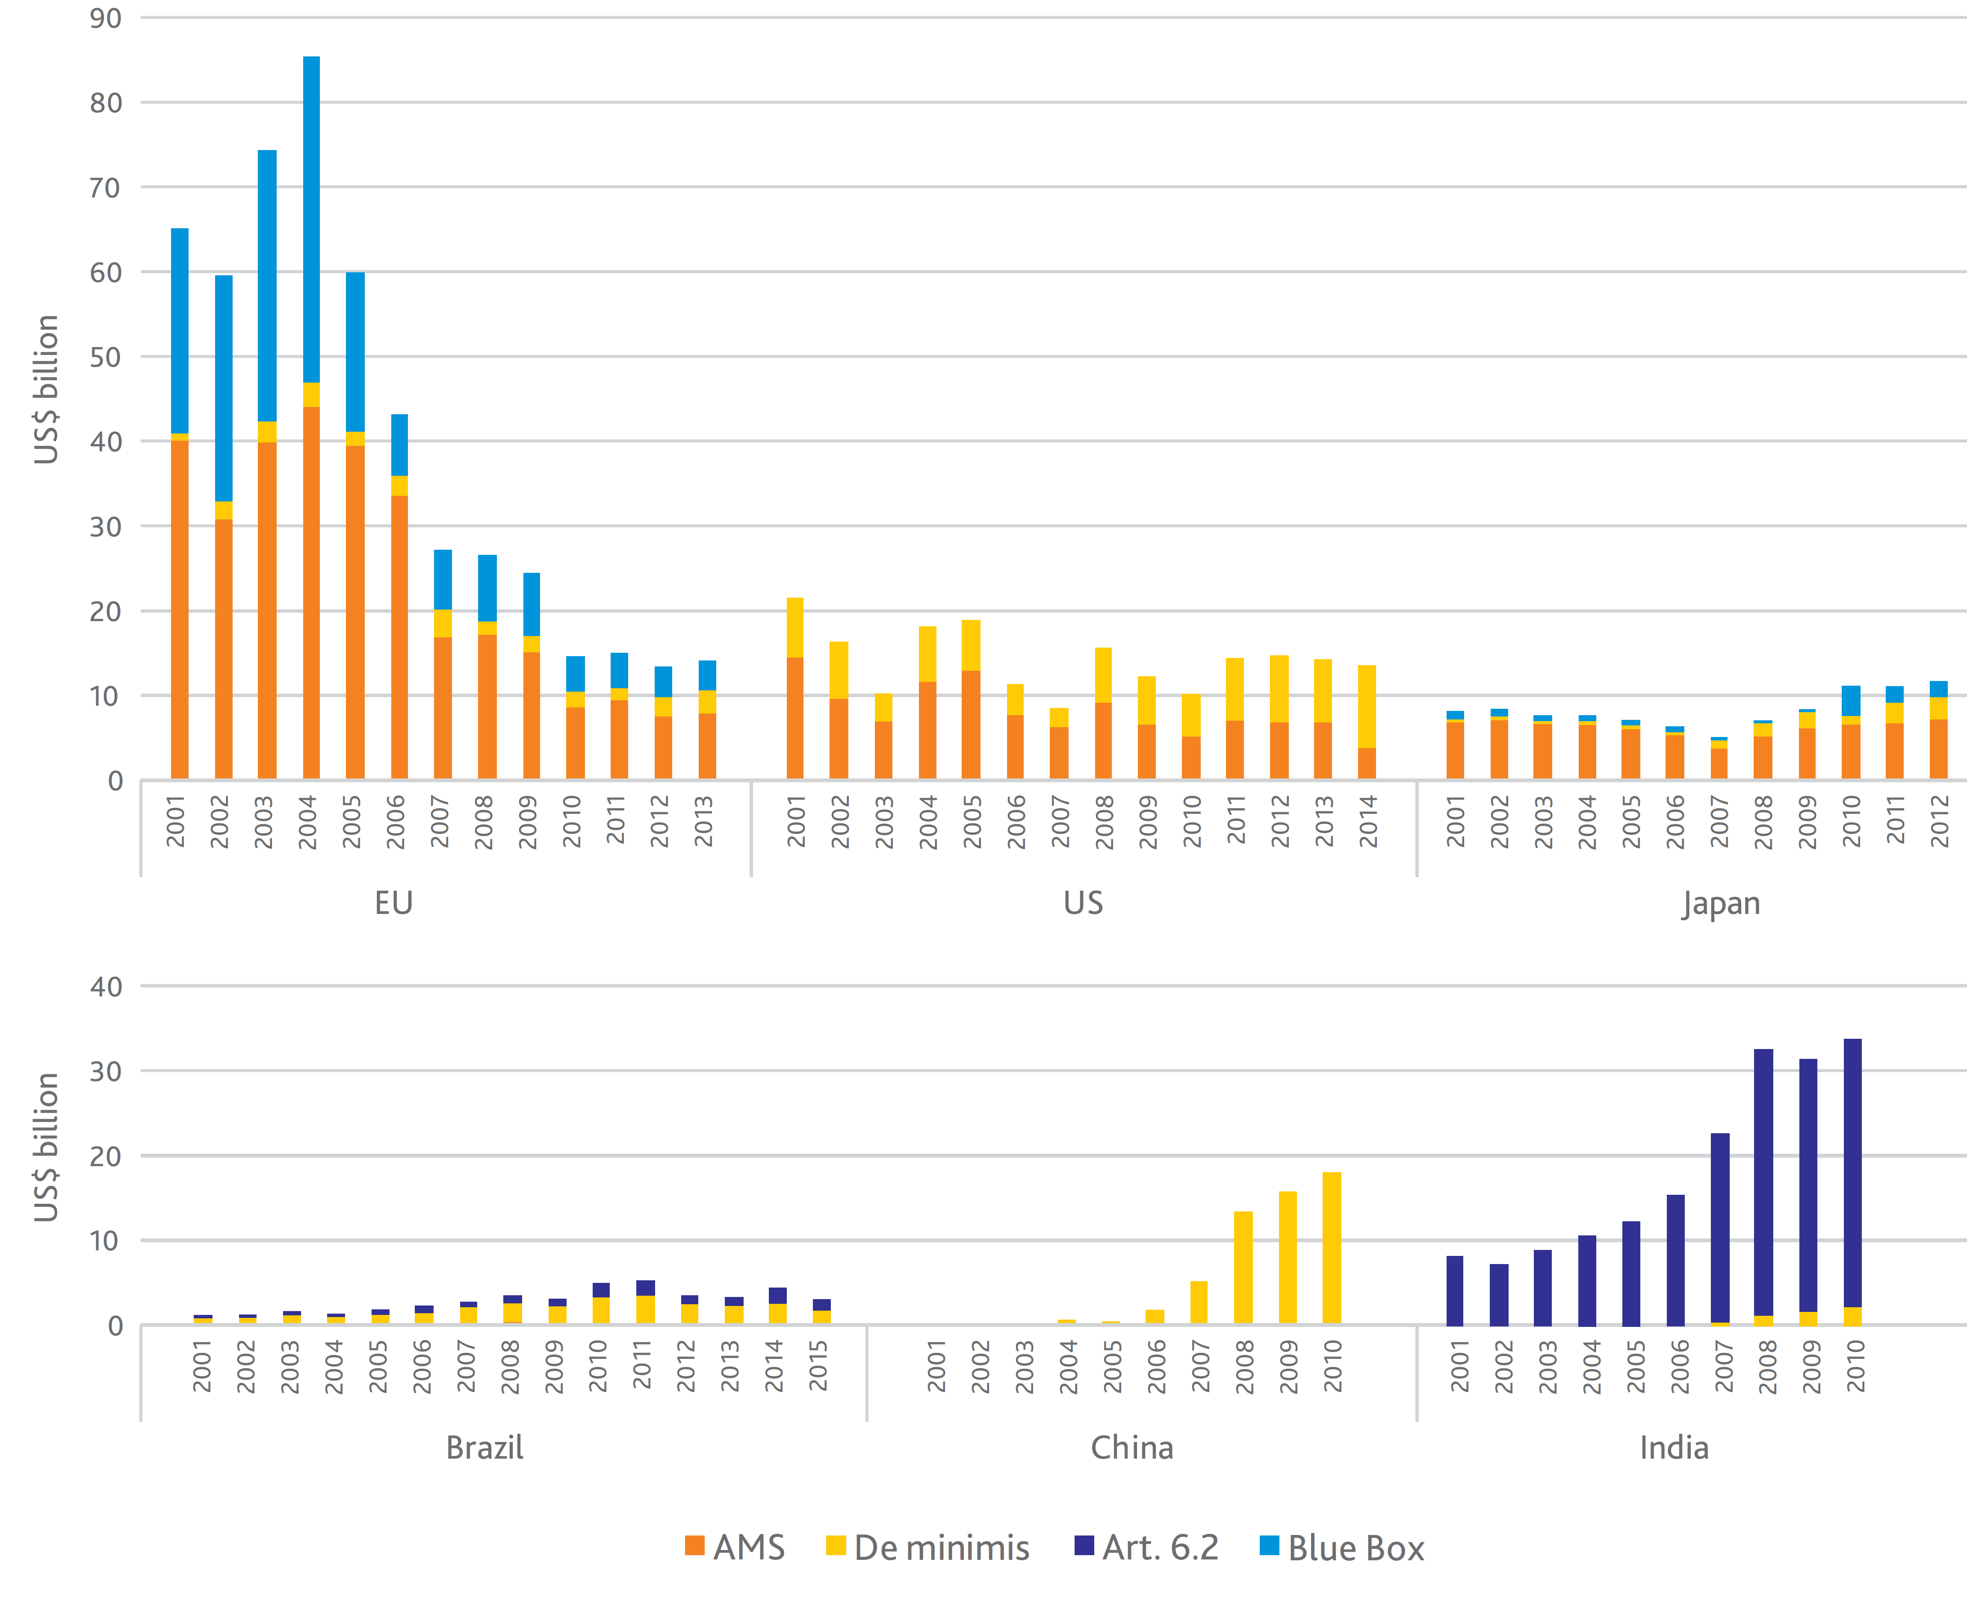
Changing Policies
Fuente: ICTSD 2017

Slide 7
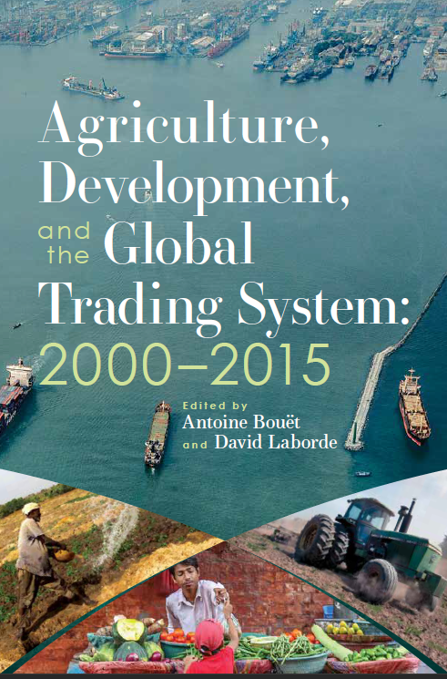
More on the last 20 years
A new book
Understanding why the Doha Round has failed
The Cost of Failure
Potential Solutions
Policy space and risk management
Beyond domestic support
https://www.ifpri.org/blog/ifpri-book-launch-how-trade-policies-can-foster-food-security

Slide 8
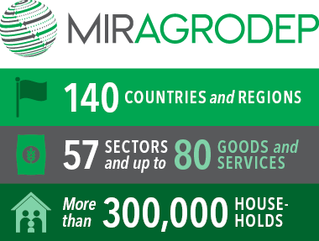
Analytical Framework
Defining Scenarios
Good data
Economic Model
http://www.ifpri.org/publication/modeling-international-relationships-applied-general-equilibrium-mirage-model

Slide 9
Scenario Design
Key Concept: Overall Trade Distorting Support or OTDS
Scenario # | 1 | 2 | 3 | 4
Label | OTDS with variable VoP | OTDS with fixed VoP | OTDS with product cap | High Ambition
OTDS limit for
Developed | 10% | 10% | 10% | 10%
China | 17% | 17% | 17% | 17%
Developing | 20% | 20% | 20% | 20%
OTDS expressed as % of | Current VoP | Fixed Reference VoP | Current VoP | Fixed Reference VoP
Article 6.2 included in OTDS | No | No | No | Yes
Product Limit | No | No | Yes** | Yes**
OTDS allowed rate reduced over time | No | No | No | Yes*
But Details matter!
But details matter!
Scenario Design

Slide 10
Impact on policy space
Scenario Design
Fuente: MIRAGRODEP model simulations 2017
Notes:
Impact on developing countries in the baseline!
Replaced by impact on developed economies in the first scenario

Slide 11
Impact on applied policies
Scenario Design
Fuente: MIRAGRODEP model simulations 2017

Slide 12
Impact on world markets
Scenario Design
Fuente: MIRAGRODEP model simulations 2017

Slide 13
Impact on exports (volume)
Scenario Design
Fuente: MIRAGRODEP model simulations 2017

Slide 14
Impact on real farmer income
Scenario Design
Fuente: MIRAGRODEP model simulations 2017

Slide 15
Concluding remarks
Reforming the Uruguay Round domestic support policy framework is possible and needed
Not doing it is increasingly costly
Discipling policy space in both developing and developed world: role of emerging countries
Basic reform will have very limited impacts in the next 10 years
More ambitious reforms with adequate product limit could deliver significant gains for some commodities: Very important to properly define “product limit”

Slide 16
¡Muchas Gracias!

Slide 17


