Slide 1

Commodity Outlook: September 2017
West Central Illinois: July 2017
William George
Senior Agriculture Economist
U.S. Department of Agriculture
Foreign Agriculture Service
Office of Global Analysis

Slide 2

Commodity Outlooks are all about Looking Forward ……
….. The Trick is Determining where the Market is Going
Notes:
When traveling through Minnesota in July, I spotted this car that reminded me of what it is like to forecast markets Commodity outlooks are all about looking forward. The trick is determining which direction is forward. Often, the best way to determine market direction is to take a look at recent price movement as these reflect both the events taking place, the data, and the market’s perceptions of those events. Together, these are our best indicators of the market dynamics and what is driving commodity markets into the future.

Slide 3
Record U.S. Soy Plantings and Brazil Harvest Send Soybean Price Lower
Brazil Soybean Harvest
March USDA Intentions
Notes:
Coming off Brazil’s short soybean and corn crops, we saw soybean prices fall following USDA’s initial forecast of record soybean plantings. Prices continued lower as the magnitude of Brazil’s harvest became apparent. Corn prices, in contrast, moved more slowly, staying between $3.40 and $3.50 per bushel. For wheat, dry weather in the southern plains kept prices elevated until spring rains arrived. However, a developing drought in the northern plains added to values.

Slide 4
Wheat and Soybean Prices Rise in July
No. Plains Drought
Notes:
A plantings report showing no change in soy area and more corn sent soybean cash prices higher. Expectations of below trend yields for soybeans added to the price rise while corn prices again remained nearly unchanged in response to large U.S. stocks. Wheat prices continued higher in response to worsening drought conditions in the Northern plains.

Slide 5
Prices Declined Following USDA’s August Forecast
USDA August Yield Forecast
Notes:
However, this all came crashing down in August with USDA’s first estimates of corn and soybean yields. Most of the price gains we saw in July for soybeans and wheat were lost in August. And for corn, prices declined to near-term lows approaching $3.30/bu.

Slide 6
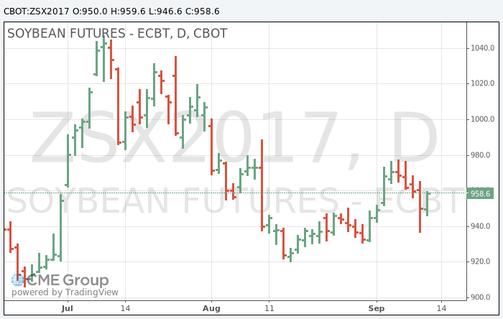
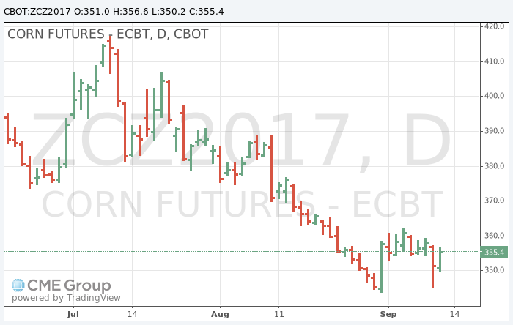
Price Impact of September USDA Forecasts Less than August
August
August
September
September
Notes:
We see these declines in cash prices are mirrored in the U.S. November soybean and December corn futures. A couple things to note here is that though the USDA September forecasts again exceeded market expectations, the market’s reaction was more muted with smaller price declines on the day of release than was observed in August. Also of note is that post September USDA forecast prices for soybeans remains above the lows reached following the August Report. This is in contrast to corn where prices are significantly lower, reflecting the underlying demand strength in the soybean market and the comparatively higher stock volume for corn in the U.S.

Slide 7
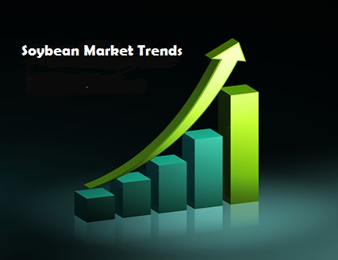
U.S. Crop Trends
Wheat, Corn, Soybeans

Slide 8
Growth in Area Harvested for Wheat, Corn and Soybeans in the U.S Slows
Wheat ↓
Corn ↓
Soybeans ↑
Notes:
Total area harvested for wheat, corn and soybeans in the U.S. has remained relatively unchanged over the past few years. This is in contrast to the previous two decades where a gradual increase in planted and harvested area was the norm. Despite this growth, the US share of global harvested area has been declining since the mid-1990s, reflecting even greater expansion in plantings in the rest of the world. (Animation) In 2017, total harvested area for the three main row crops in the United States is projected reach a bit more than 85 million hectares, close to the average area harvested since 2012. Both wheat and corn area are lower, partly offset by an increase in soybean plantings.

Slide 9
U.S. Soybean Harvested Area Continues to Expand
Notes:
In 2017, we saw a significant increase in soybean plantings after three years of relatively stable area. The relatively high prices observed in 2016 and record export demand over the past two seasons drove this year’s plantings higher with soybean harvested area projected to exceed corn for the second time.

Slide 10
U.S. Soybean Production to Reach New Record on Larger Area and Above Trend Yield
Notes:
Though yields are down from last season’s record, they are on track to be the second largest observed, exceeding the trend yield. Accordingly, the total quantity harvested is projected to reach a record. This yield is much higher than the market anticipated in August and exceeded most market forecasts for September.

Slide 11
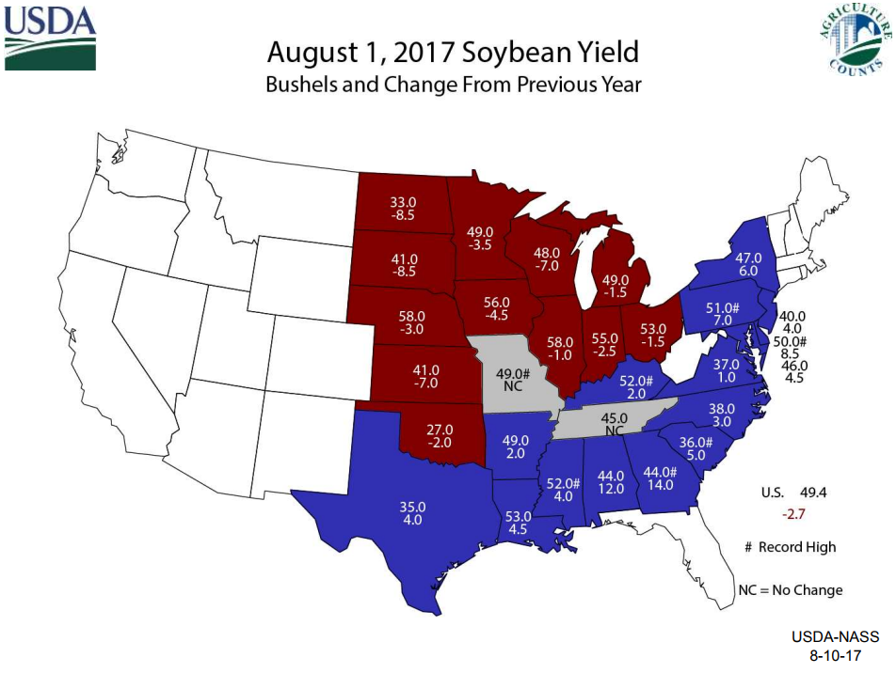
Notes:
Looking at yields by region, we see that this year’s lower yields reflect a return to more normal growing conditions in the principal producing regions. Yield increases are confined to southern areas and the North East where ideal conditions existed. In fact, record yields were observed in many of these states.

Slide 12


USDA-NASS
9-12-17
Notes:
With the increase in USDA’s September soybean yield, we see an implied record pod weight. Pod counts are the lowest since 2013 and are surveyed for the report. Pod weights, however, are implied from the yield forecast with the forecast verified once actual harvest data is received. This data will influence both the October and November USDA production forecasts.

Slide 13
U.S. Corn Harvested Area Declines on Slowing Trend
Notes:
Turning out attention to corn, corn area in the U.S. declined in 2017 as producers switched to soybeans. This decline follows a trend of slowing growth in corn area that is evident in the long-term trend.

Slide 14
U.S. Corn Production to Decline with Reduced Yield
Drought
Notes:
With an expected decline from last year’s record yields, and lower planted area, total corn production is projected to decline from last season’s record. While forecast production is lower, it is consistent with the higher production levels observed since the 2012 drought.

Slide 15
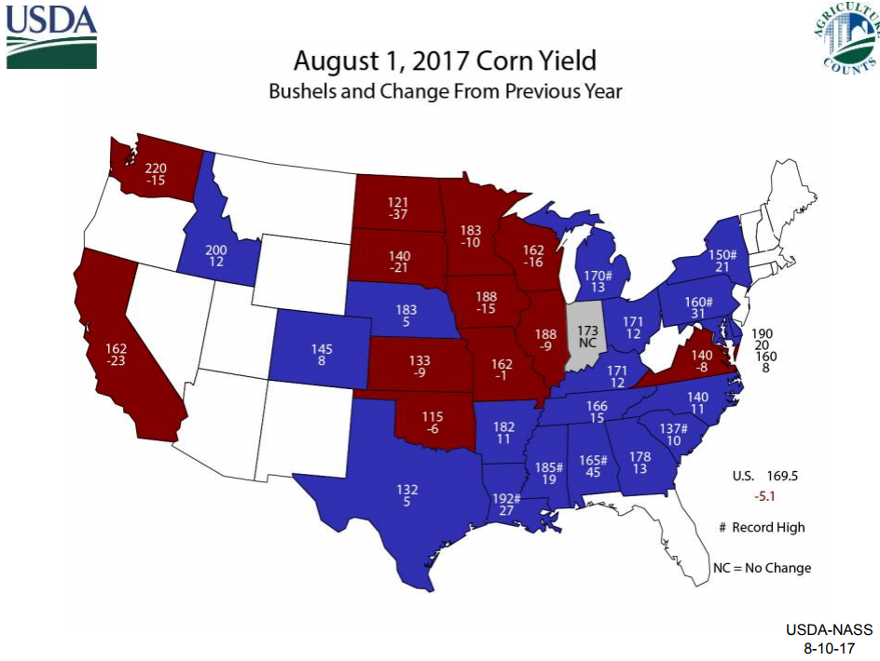
Notes:
For corn, we see a similar distribution as was seen with soybeans with lower yields in the central corn belt with higher yields mostly limited to southern areas and the North East where some states, similar to soybeans, are expected to see record yields. High temperatures at pollination, particularly in the western half of the corn belt, and drought in the Dakotas helped push yields lower. One difference with soybeans is that yields for corn are projected to rise in the eastern corn belt. Wet conditions generally benefitted earlier planted corn whereas later planted corn and soybeans generally struggled early in the year. However, conditions improved later in the season benefitting all crops.

Slide 16
USDA-NASS
9-12-17
Notes:
With corn, USDA is expecting the third highest ears per acre on record for the 10 State survey region. And if realized, 2017 would be the 3rd highest ear weight on record

Slide 17
U.S. Wheat Harvested Area Trending Lower
Notes:
Turning our attention to wheat, we see that wheat harvested area has been on a downward trajectory in the U.S. for the past 30 years. While the rate of decline slowed beginning around 2000, it has accelerated over the past few years reflecting lower returns relative to other crops. Increasing competition from eastern Europe and Russia, declining growth in consumption in the U.S. in response to low carb diets and gluten free products, and rising stocks have all contributed to the decline. In fact, wheat plantings in the U.S. declined to their lowest level in nearly 100 years.

Slide 18
Wheat Production and Yield Decline in 2017
Notes:
Looking at production and yield, we see rising yields have mostly offset the decline in area harvested. While last year’s record yields pushed production to it’s highest level since 2008, a return to the lower yields seen for most of this decade, along with a precipitous drop in plantings dropped total production to the lowest level in 15 years.

Slide 19
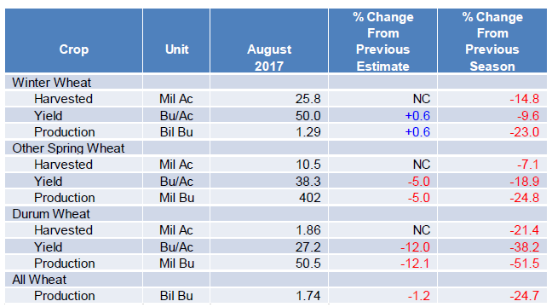
Wheat Yields and Production Fall in 2017
Notes:
Looking at the various wheat classes, we see that Durum wheat saw the greatest declines in harvested area and yields resulting in production falling more than 50 percent from last year. Other spring wheat also saw a significant decline in harvested area and yield resulting in a 25 percent decline in production. Yield reductions for both durum and other spring wheat was significantly impacted by drought in the upper mid-west. Winter wheat yields which declined 10 percent from last year were influenced by excessively dry early season conditions in the southern plains. Final figures will be reported at the end of this month.

Slide 20

Where does this take us into 2017/18?
Lets look at each commodity separately
Notes:
So, where does this take us into the coming year? Let’s look at the market dynamics for each, beginning with soybeans, and see what insight we can gather.

Slide 21
Record Soybean Stocks to Continue into 2018
Notes:
With record 2017 harvests in both Brazil and the U.S., and generally good to record crops in Argentina, Paraguay, Canada and Ukraine, stocks are forecast to remain at record levels. Brazil is expected to carry-over record supplies into 2018 while stock holding in Argentina, encouraged by the expected future decline in export taxes, will rise. When viewed in relation to disappearance, which includes both exports and domestic use, we see that you need to go back about 10 years to see a larger stock/use level.

Slide 22
Current Exporter Stocks Remain High…
…Stocks to Use Comparable to 2011
Notes:
Looking at current stock levels, with Argentina and Brazil converted to an October to September period, the volume of stocks remains at record. However, with much larger disappearance, stocks relative to use among exporting countries are not too far removed from where they were at the beginning of the decade.

Slide 23
Current and Forecast U.S Farm Prices Comparable to 2010
Notes:
Prices today are comparable to what they were then, though somewhat reduced today due to lower soybean oil prices that in the late 2000’s were high, benefiting from strong biofuel demand and significantly higher energy prices. Prices are also significantly higher than they were a decade reflecting the emergence of China as a growing buyer of soybeans.
While current prices remain low, we see little additional price decline in the short term, primarily due to the strong demand for protein feeds. This is especially true as the reduced soybean prices enhance profitability in the feeding sector, encouraging additional demand growth.

Slide 24
China’s Demand Drives Imports
Notes:
When looking at trends in global soybean imports, we can see China’s importance in driving trade. Here we see the almost linear growth in China’s soybean imports. In addition, we also see an uptick in imports by other markets corresponding with declines in the soybean price. While this rise in demand is certainly encouraged by lower prices, the opening of markets in Iran and the changing dynamics in South Asia also come into play. The EU, always an important importer of both soybeans and meal has not helped drive demand higher. This is due to a number of factors including slower meal demand growth and the abundance of rapeseed and sunflower seed available.

Slide 25
Soybean Trade Eclipses Meal in Consumption Growth
Notes:
We can see this increase in demand for soybeans outside of China by looking at annual demand growth for soybean meal, excluding China. What we find is that imported soybeans, as a source of soybean meal, has been rising faster than imported meal, whose annual growth has been slowing over the extended period.
Over the past 15 years, the trend in annual growth in global soybean meal trade has declined marginally from about 1.8 million tons in the early 2000’s to about 1.4 million tons today. In contrast, the soybean meal equivalent of soybean exports, excluding China, has gone from negative growth to approaching 3 million tons today. Considerable variability is evident in the chart from one year to the next. However, these trends likely reflect the impact of weak growth in EU meal imports, declining Indian exports and growing soybean trade to South Asia and Iran and Vietnam over the last few years.

Slide 26
Import Growth Accelerates
Notes:
Looking at import demand growth, we see demand increasing at a growing rate, spurred on by the lower prices seen over the past few years. Current demand for imported soybeans is roughly 8 to 10 million tons per year, roughly double the level of ten years earlier.

Slide 27
Consumption Growth Mirrors Trade
Adds to Total Demand
Notes:
When we add to this the demand for domestically produced beans, either consumed locally or exported as meal and oil, we see total annual demand reaching between 14 and 16 million tons. Again, double the level observed 10 years ago.
Given these trends in trade and consumption, it’s safe to say that demand will continue to grow. It is this strong demand that has helped keep prices above the levels observed a decade ago and why the downside in price movements is somewhat limited. And it also places, by the sheer magnitude of the annual increase, the supply side forces in the driver seat with regards to future price movements. With soybean consumption rising 15 million tons a year, it is easy to see how we are just a short harvest away from tighter stocks and higher prices.

Slide 28
Exports Set Records Every Year in Brazil and U.S.
Notes:
The result has been record or near record soybean exports for both Brazil and the U.S. for most years. This is a trend we expect to continue into the coming year given current production forecasts. So, while producers face lower prices, higher yields have allowed for growing sales volumes, compensating some for the lower prices received by producers

Slide 29
Exports from Other Markets Fail to Match U.S. and Brazil Growth
Notes:
Soybean exports outside of the US and Brazil have been noticeably more stable with export growth primarily linked to production growth, offsetting declines in other markets. This is not different in the coming year where export gains in Canada are directly related to the expansion of soybean production in southern Manitoba and Saskatchewan.
Before we move on to the other commodities, there are a couple of additional points that can be made.

Slide 30


Producers have Many On-Farm Storage Options
Grain Bins and Silo Bags are found on many Farms
Notes:
A significant portion of exporter stocks are being held in Argentina. With the advent of low cost on-farm storage using silo bags or, as is the case in the U.S., on-farm grain bins, effective supplies can decline with prices as producers withhold sales. In Argentina, with an expected reduction in export taxes beginning in 2018, incentive is to hold soybeans for later sale, especially if prices remain relatively stable and at today’s lower values. This ability to hold crop cheaply for later sale is one factor limiting potential price declines from current levels.

Slide 31
South American Producers Facing Sticker Shock
Notes:
Looking at soybean prices faced by producers in the U.S., Brazil and Argentina, factoring in exchange rates and compensating for inflation, in effect a constant dollar using January 2015 as a base price, we see that U.S. producers have faced today’s low prices for much longer. In fact, current prices are above the lows seen in late 2015 and early 2016. For South American producers, current prices are much more of a reality check as they are significantly below the levels seen for most of the past 3 years. Market psychology is an interesting subject to ponder but a difficult one to incorporate into forecasts. However, in this case it suggests that U.S. producers may be a bit more willing to part with their crop at current prices then South American producers. Also, U.S. producers have had a longer time to adjust to marketing in a lower price market.

Slide 32
Export Market Competitive on Price
Notes:
And finally, while earlier in the period, U.S. producers faced a higher export prices relative to their South American counterparts, export prices of late have been much more uniform. During our normal slow period from March through August, corresponding with the South American harvest and their peak sales period, U.S. exports fall to minimum levels. In 2016, given the short crop in Brazil, our sales for the period were near record levels as Brazil was running out of supplies. We saw this again in 2017 with a similar level of sales, this time despite a massive increase in the Brazil crop and record volumes being exported. This says something about the strength in global demand. However, with export price offers being fairly uniform, price becomes less of a factor in a buyer’s choice of where to source their purchases. Other factors such as quality, reliability, and relationships take on an increasing role in purchase decisions. Given that the protein content of this year’s Argentine harvest has been reported to be the lowest in 20 years, this may be one factor influencing the low level of soybean exports observed recently.

Slide 33
Global Corn Stocks Forecast to Decline
Notes:
Turning our attention to corn, global corn stocks are forecast to decline in the coming year, primarily due to a draw down in China’s stocks to a level last seen in 2013/14. Stocks in other countries, as a whole, are forecast to decline as well as Brazil draws down stocks next year following this year’s record harvest. Stocks in the U.S. are also forecast to decline marginally in the coming year but will remain historically large.

Slide 34
U.S. Corn Prices Face Further Declines
Notes:
U.S. corn prices are forecast to decline a bit in the coming year, dragged down in part due to a lower expected soybean price. At $3.30/bu, it is down significantly from 2013/14 when prices in the U.S. averaged nearly $4.50/bu. AS is the case this year, higher soybean and energy prices had a lot to do with the elevated price compared to this year. It should also be noted that though global stocks were comparable to this year, U.S. stock levels are nearly double what they were in 2013/14. And with global exports representing only about 14 percent of total disappearance compared to about half for soybeans, the likelihood that a significant downturn in production prospects elsewhere can lead to a significant draw-down in U.S. stocks.

Slide 35
Global Corn Consumption Growth Continues to Trend Higher
Notes:
Global Corn consumption continues to trend higher, with the coming year forecast to rise about 25 million tons from the current year. Consumption growth is fairly consistent across major countries and regions.

Slide 36
Global Corn Exports Forecast to Decline
Notes:
Global corn exports continue to trend higher, though are expected to fall slightly from the current year in response to lower U.S. exports. Exports last year benefitted from the reduced corn output from Brazil due to drought, with the impact also being felt in other exporter countries. With this year’s record production in Brazil, and a continued shift in Argentina to more corn area, U.S. export volume is expected to return to near historic levels, reducing the potential for any significant draw-down in U.S. stocks.

Slide 37
Global Wheat Stocks Forecast to Rise in the Coming Year
Notes:
Turning our attention to wheat, stocks are forecast to grow in the coming year with most growth occurring in consuming countries. Stocks in major exporting countries are forecast to fall with U.S. stocks taking the biggest hit.

Slide 38
U.S. Prices to Rise as Lower U.S. Production Reduces Domestic Stocks
Notes:
Wheat prices in the U.S. are forecast to increase in 2017/18 following this year’s reduced plantings coupled with declines in yield. Higher prices needed to encourage additional area, especially for spring wheat varieties where alternative crops such a dry beans and lentils currently show greater profit potential

Slide 39
Global Wheat Consumption Continues to Grow at a Slow Pace
Notes:
Global consumption will continue to grow in the coming year, though at a slow pace. Growth markets continue to be Asia, India and the Middle East as wheat consumption remains flat to declining in many developed countries.

Slide 40
Global Exports Forecast to Remain Near Current Levels
Notes:
Global exports likely to remain close to this year’s level with continued expansion in Eastern Europe and Russia helping to boost exports. Lower production in the U.S. and Australia will likely lead to lower exports from these countries

Slide 41
Outlook Summary: What You See is What You Get
Current Corn and Soybean Prices Expected into 2018
Wheat Prices Forecast to Rebound from Current Lows with lower production in the U.S. and Australia and increased competition from Russia and Eastern Europe in Export Markets.
Strong Demand Growth Boosts Soybeans Potential to Move Markets
Corn Markets will Likely Follow Soybeans
Notes:
In conclusion, the best way to describe the outlook for next year is “What you see is what you get”. Current low prices for corn and soybeans are expected to continue into 2018 baring any significant production issues developing in South America and elsewhere in the southern hemisphere. Wheat prices are forecast to rise from current low levels, particularly with lower output in the U.S. and strong competition from Russia and Eastern Europe. The soybean market has the greatest potential to change direction given the higher demand growth and larger share of global output yet to be planted and harvested in South America. The corn market will likely follow soybean’s lead with regards to pricing while higher wheat prices will be needed if additional area is to be planted in the U.S.

